Slide 1
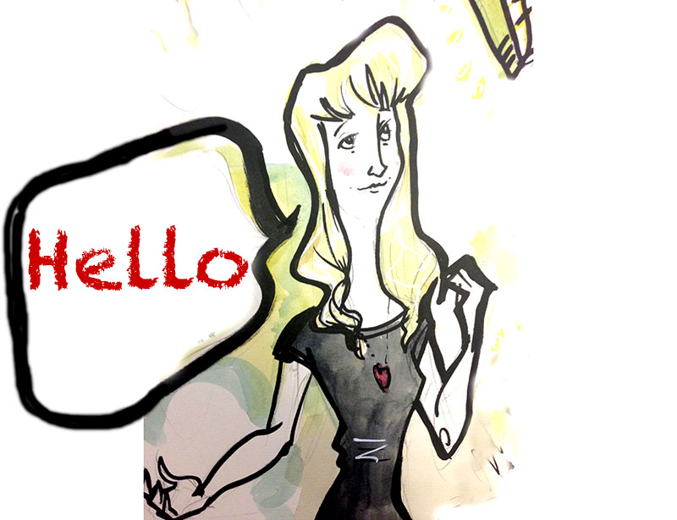

Kath Penaluna
© Karl Mountford 2010
@KatPen

Slide 2
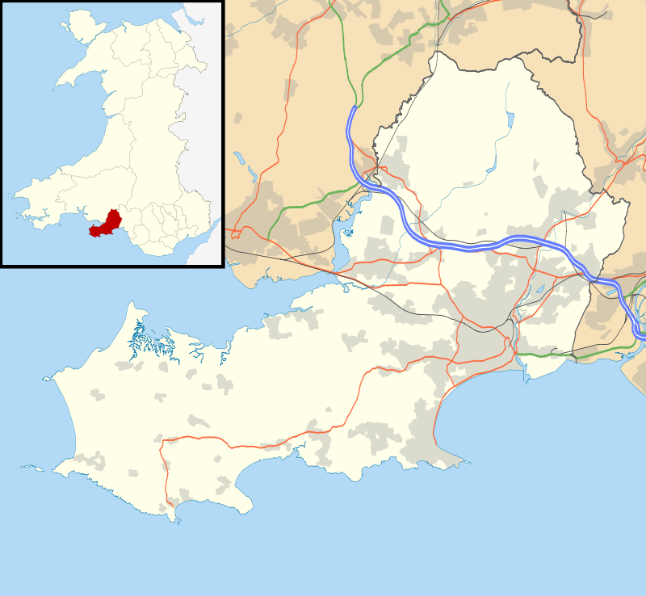
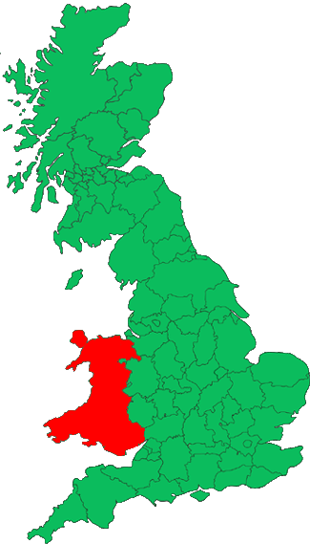


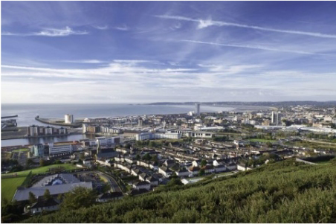
UNESCO
Entrepreneurial Learning City
Swansea, Wales, UK

Slide 3


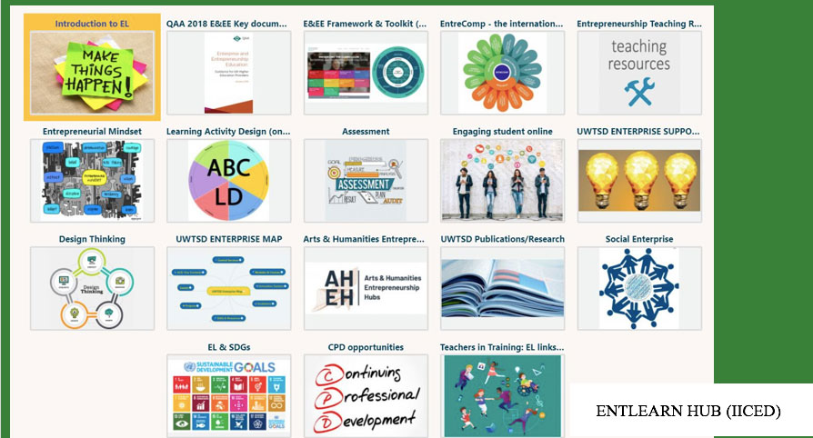
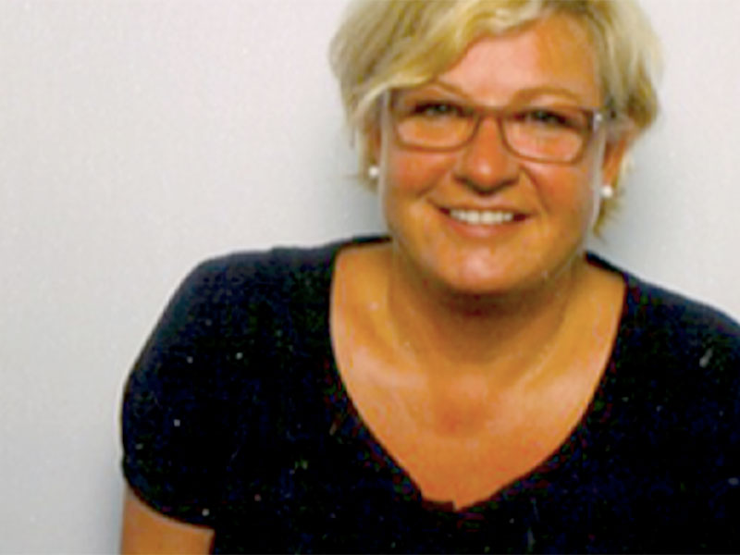
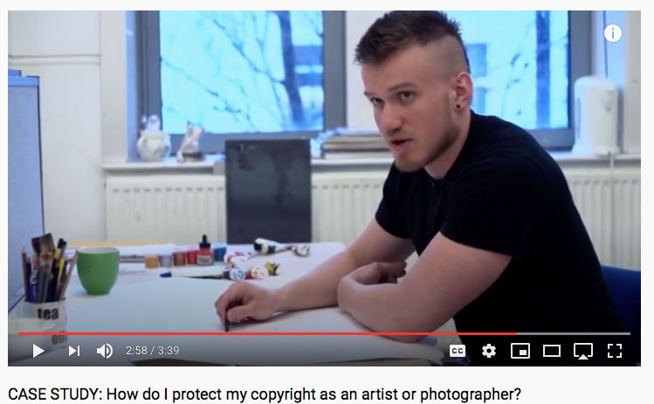
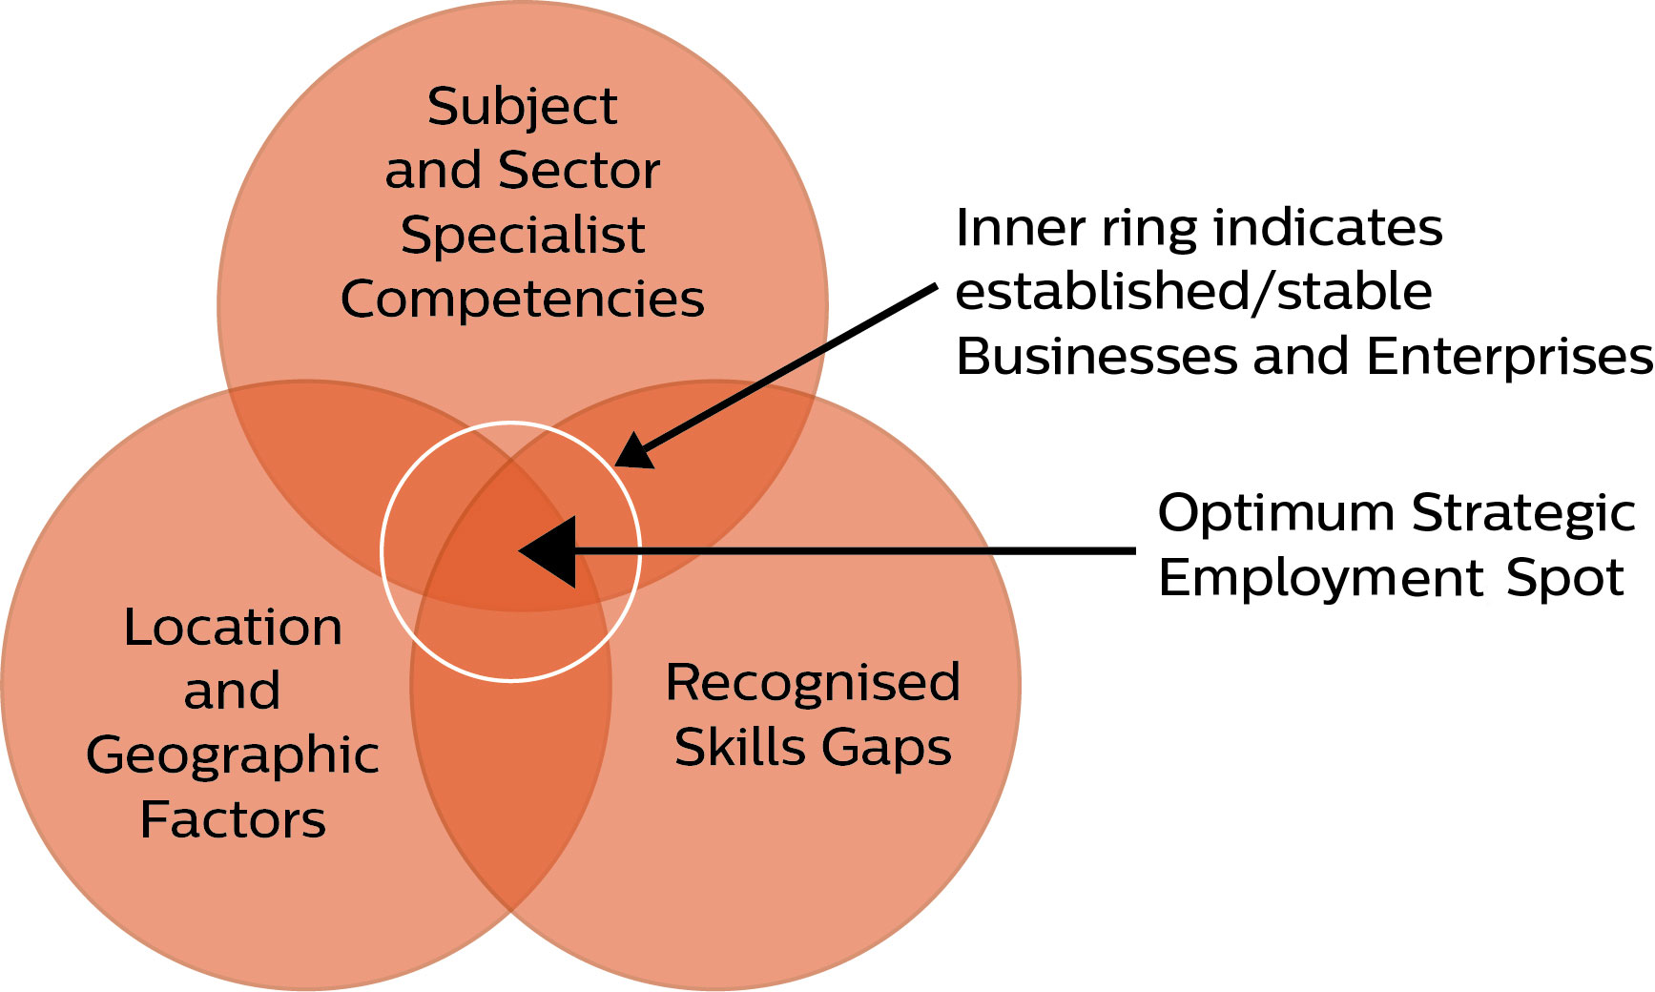
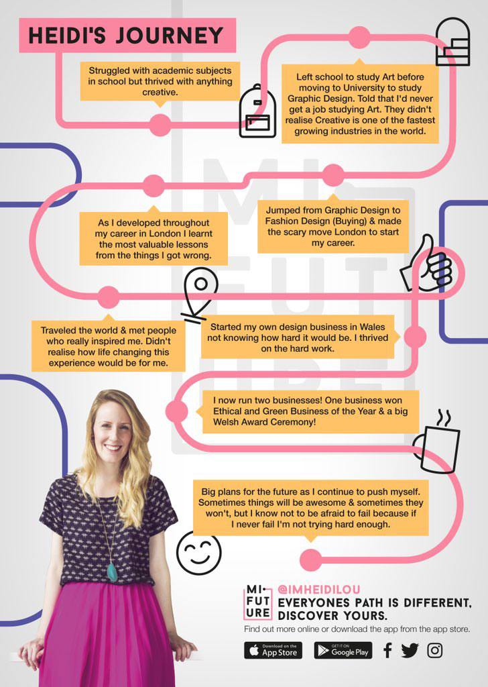

Enterprise and Entrepreneurship
Leadership roles in frameworks like QAA, AdvanceHE and EU’s EntreComp
700+ Grad Businesses and 550 survival over 3 years – UK leading
Top level awards and alumni who ‘help back’ with curriculum development
and support – work with Academic Champions within subject areas.
International learning continues, e.g. 200,000 UN Empretec students trained - based on UWTSD IICED curriculum for innovation and sustainability

Slide 4
Making connections: Skills and support

Slide 5
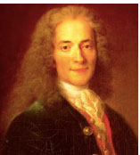
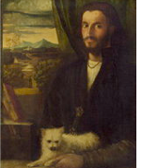
Lets think about our thinking
“Uncertainty is an uncomfortable position. But certainty is an absurd one.”
Leonardo Da Vinci
(A bastard with no surname) 1452 – 1519
Voltaire 1694 - 1778
(François-Marie Arouet)
“To develop a complete mind; study the science of art; study the art of science. Learn to see. Realize that everything connects to everything else.”

Slide 6
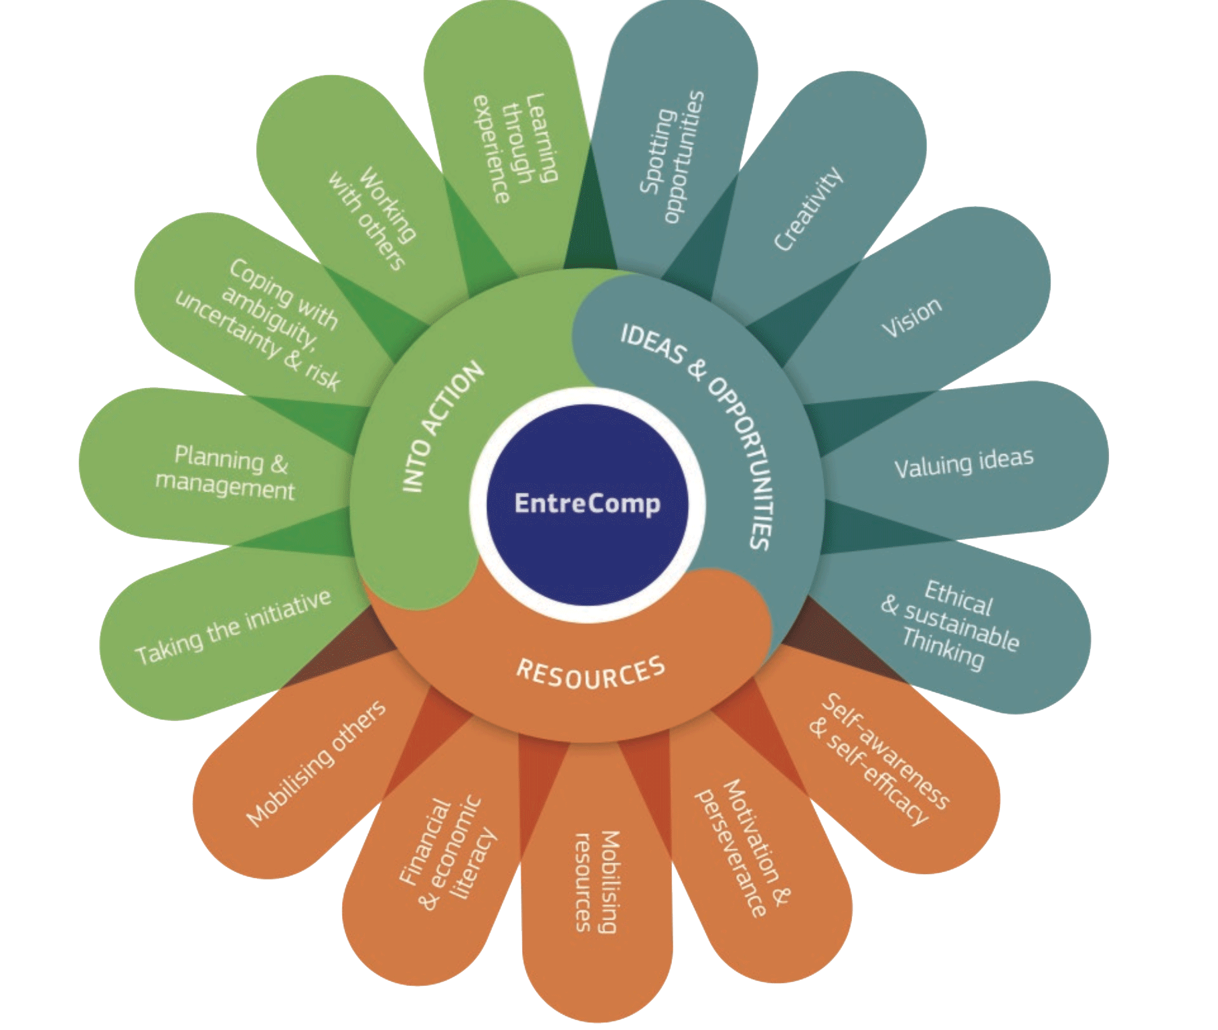
What competencies do you have?
…and what do you need?

Slide 7
Our initial focus

Slide 8
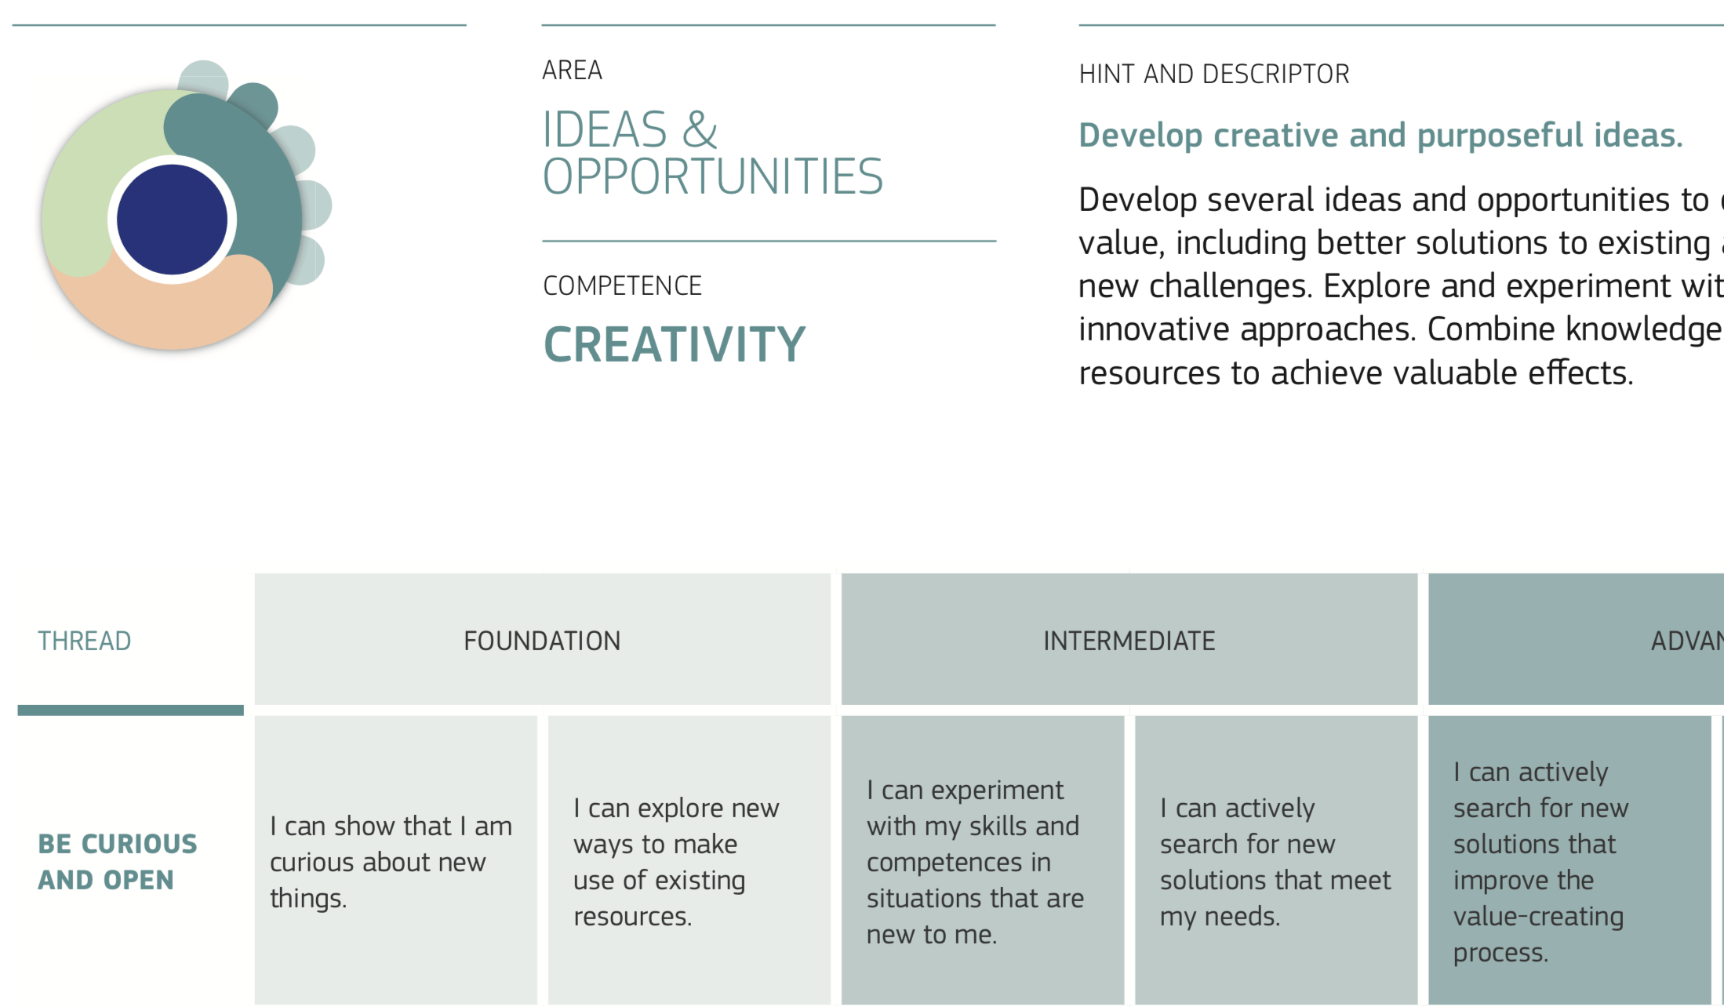

Slide 9
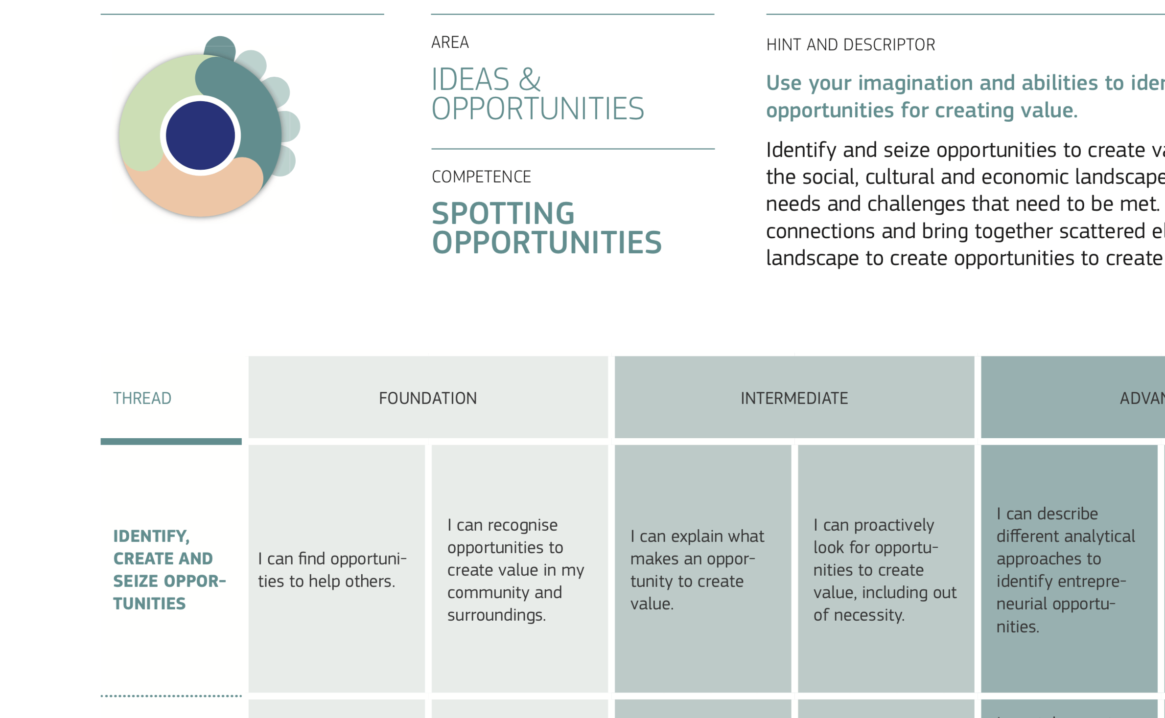

Slide 10
Triggers for thinking: What’s necessary?
Necessity Entrepreneurs
Have obvious ideas and tend to copy others
Are motivated by survival and money
… but seem to have no effect on economic development
http://www.mitpressjournals.org/doi/abs/10.1162/itgg.2006.1.1.97#.VidMUump3AM

Slide 11
Triggers for thinking: Why opportunity?
Opportunity Entrepreneurs
Have new ideas, spot opportunities and act
Are intrinsically motivated and constantly alert
… and have a positive and significant effect on economic development
http://www.mitpressjournals.org/doi/abs/10.1162/itgg.2006.1.1.97#.VidMUump3AM

Slide 12

Isn’t creativity just making new connections?
KILLS BUGS FAST
Good creative connections can be a puzzle – yet deep down you know the answer already
© Neil Issac 2016

Slide 13


Do you see things differently?
Notice objects, shapes, patterns, or simply look at something from another person’s perspective, ideally someone a lot different to you?

Slide 14

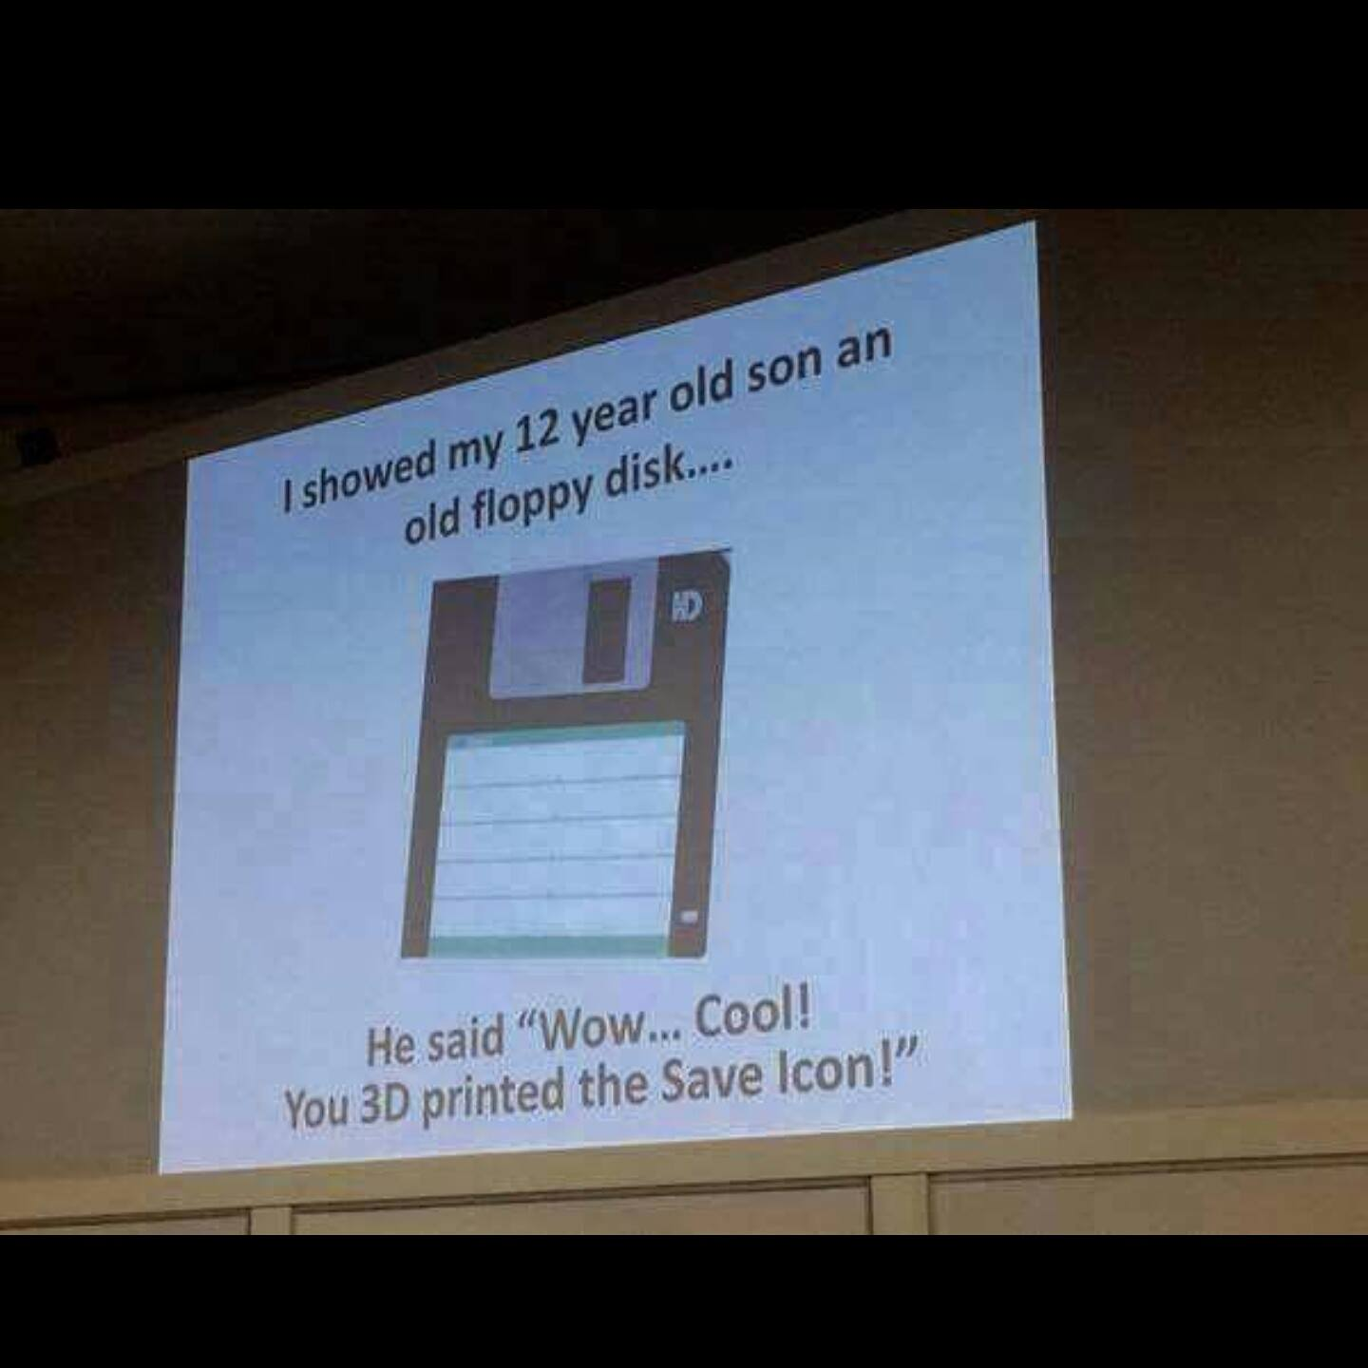
Do you see things differently?
The world is full of dots, how you connect them is at the root of Intellectual Property?

Slide 15
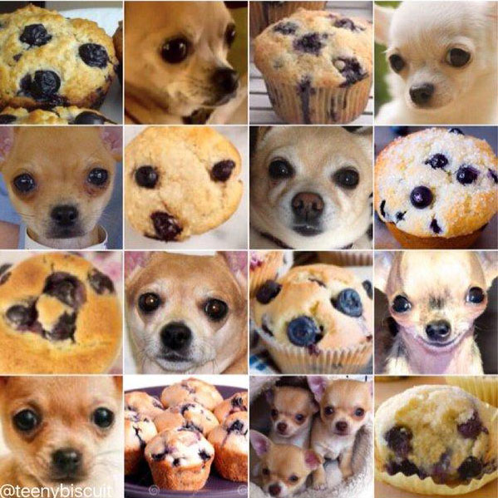
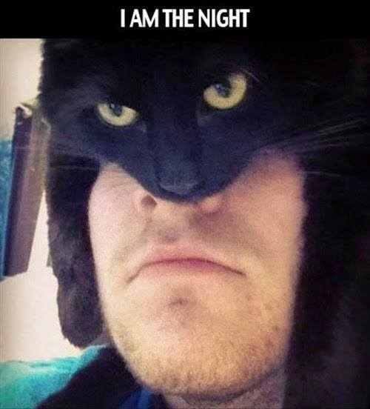

Mix things up to see something new
What was new?
Newness is key – or there is no IP

Slide 16
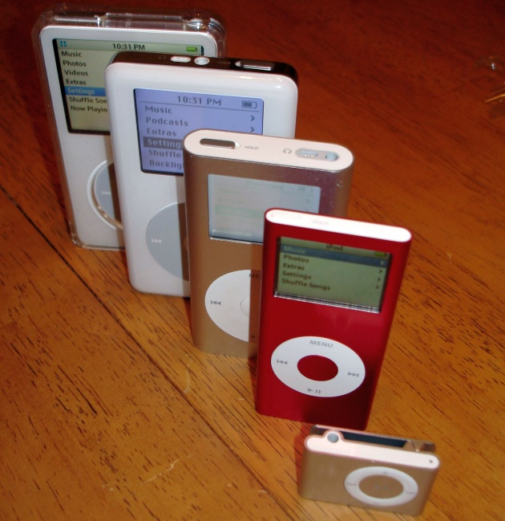

Joining the dots backwards to 2001
What was new?
The iPod's wheel technology can measure changes in position greater than 1/1,000th of an inch

Slide 17
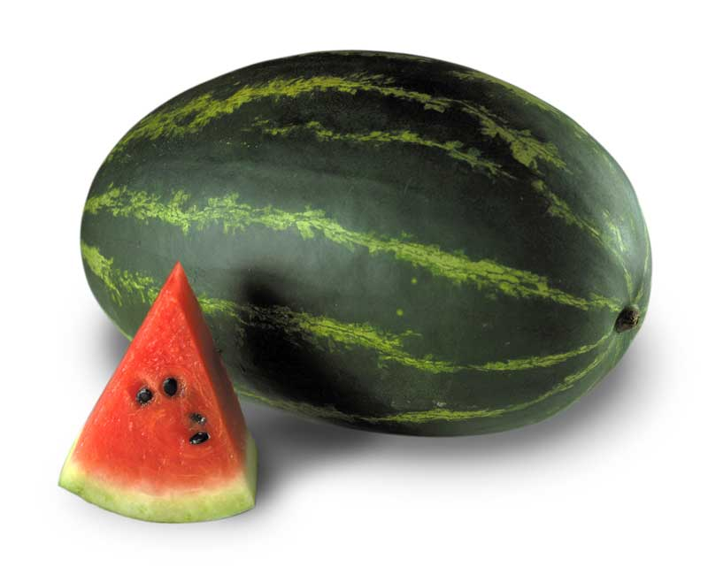
How many uses can a watermelon have?

Slide 18
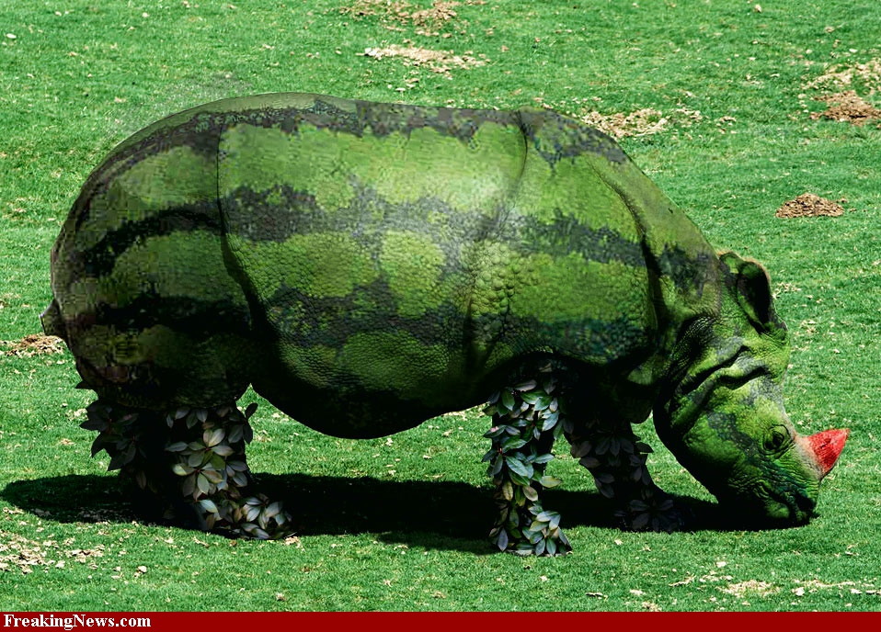
What’s wrong with the shape?

Slide 19
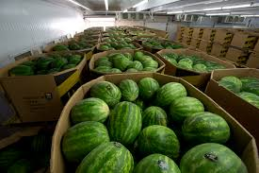
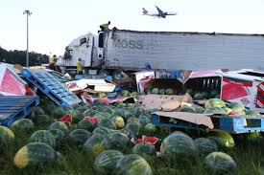
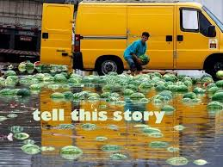
Creative minds connect in many ways
As a result…
The demand for water melons has exceeded expectations!!!
How can we ever transport them safely all over the world?

Slide 20
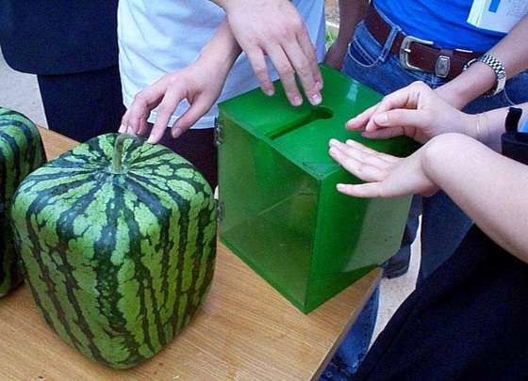
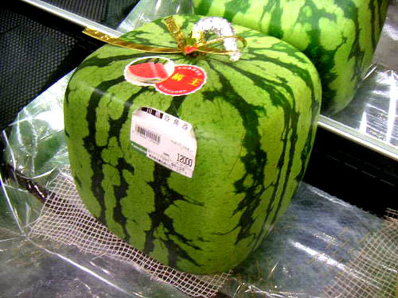
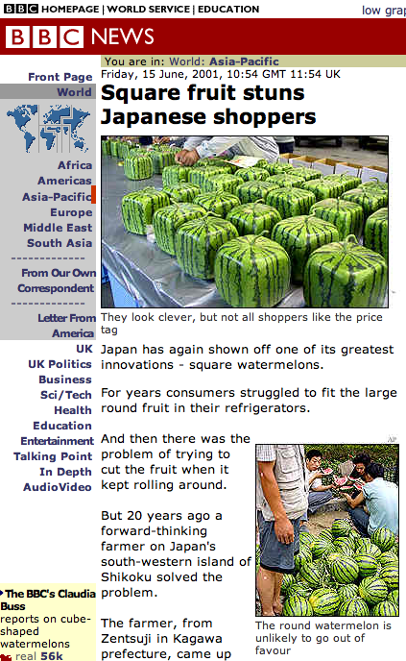
Ideas can add value,
and at minimal cost

Slide 21
When do you have your best ideas?

Slide 22
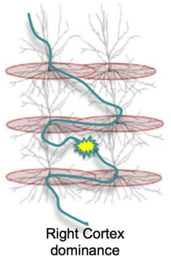
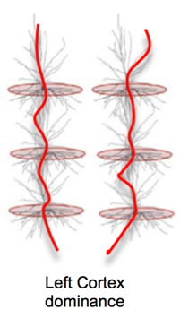
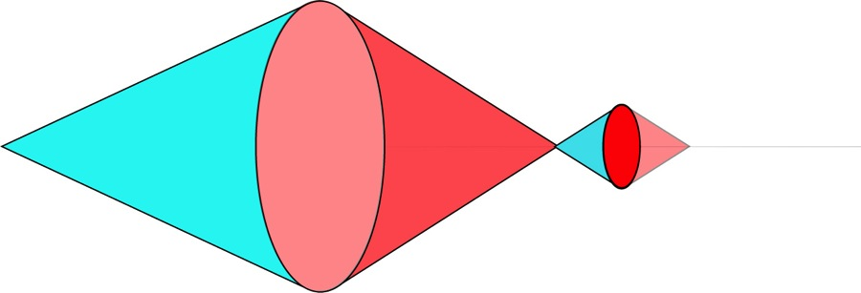



Understanding creative thinking
Often Subconscious thinking with ‘Aha’ moments of enlightenment
Thoughtful and conscious ‘step by step’ thinking
New information
Divergent - Convergent thinking
Penaluna & Penaluna 2006

Slide 23


Thinking about thinking as an innovator – the journey
Will they work? Test, Check Contrast
Making new connections and seeing things differently
Spotting change & being adaptable with new information
Having lots of views and ideas
DISRUPT
Divergent - Convergent thinking
Penaluna & Penaluna 2006

Slide 24




Synaptic efficiency
repetition, consolidation, certainty of solutions, measurement against expectations
Is the learning brain working?
Synaptic plasticity –
adaptability, flexibility, originality, novelty, holistic perspectives, empathy

Slide 25

Valuing your product/service - Intellectual Property

Slide 26
Protecting your creativity
Protecting how your work is used, for commercial, social or cultural purposes – from outset (leaving it later always equals problems).
Making your own decisions, based on an understanding of your rights – if you don’t know do your research.
Ensuring your don’t infringe other’s rights – more research

Slide 27
A brief summary of IP assets: What could be my opportunities?
Patents
…protects invention
Copyright
…protects the author
Trademarks
...a distinguishing mark
Registered Designs
...protect appearance

Slide 28


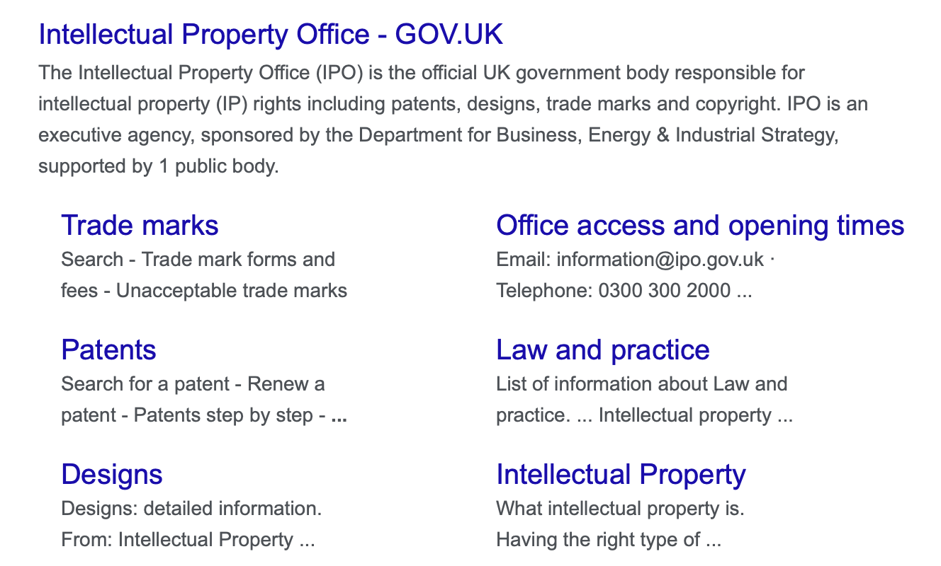
First port of call - Resources at UKIPO
Dafydd Williams – moral rights
https://www.gov.uk/government/organisations/intellectual-property-office
https://www.youtube.com/watch?v=v59aqvLPPp4

Slide 29

Developed from:
© R Soetendorp 2018
Thinking about thinking:
The slippery questions
Who will be working with the IP?
What IP could be involved?
What decisions you make up front determines what happens
Who wants / owns what with the IP?
What ‘quasi’ IP could be involved?
First idea

Slide 30
Team and funding

Slide 31
No Pain
Let’s think about pain points
Is there some hidden pain they haven’t spotted yet? What changes are afoot that might mean it could be on the horizon?
Have you spotted someone having a problem?
Are there solutions already or have they been overlooked? Maybe not good enough or bespoke enough for those people?
Can you come up with a range of ideas to share that may solve this problem?
Can you do research that makes your solutions easy to explain?
Can you explain them in terms of what value they bring?
Some Pain
Is it improving or will it most likely get worse? What are the root causes and can you discover them?
Great Pain
Can you understand why it has got this bad? What could have been done earlier and what are the priorities now?

Slide 32
Let’s think about novelty
versus value
The more novel, the more difficult it is to get buy in – needs great communication skills
Very new and different
New with high potential
The sweet spot mixes visionary skills with high value potential
Small change / value obvious
NOVELTY
The more obvious, the more competition, so quality and price matter most
VALUE

Slide 33
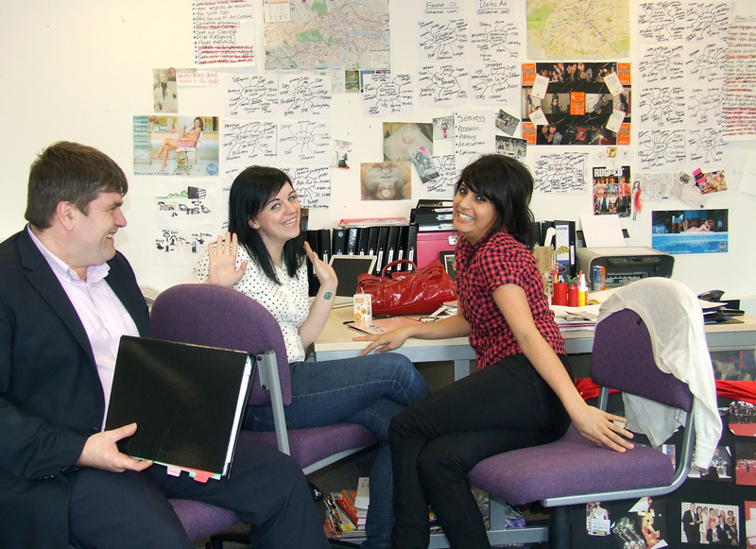
Let’s think about explaining
A real skill is being able to reflect, think and explain your thinking to others.
A funder, sponsor or customer will all need persuading.
Ask why am I doing this?
Who will benefit and why would they pay?
What are the problems that other people haven’t spotted yet, or are doing very little about?
How do my abilities match the solving of these problems and who else do I need to help me?
UWTSD students explain their big ideas to Professor David Gibson OBE

Slide 34

Money expertise
Let’s think about contacts
In the world of work you want to link who you know to what they do and how they may or may not be able to help you. Everyone has their own personal set of contacts.
As you develop you will meet new people and ideally, you will have done such a good job that they will recommend you to others.
You can get started now by simply drawing up your own network web and adding to it as you go along. Make each section a profession or useful type of contact, then place names according to how much you may need their services.
Think of it as a dartboard too, where have you scored a network success and where do you need to land your next dart?
Clients
Moral support
Professional bodies

Slide 35
Time I spend
Let’s think about value in
as well as value out
Simply keep a record of the time it takes you to do things, maybe a Uni project for example. A diary is a good way to keep a timesheet record.
Business survival is often based on a single issue and that’s cashflow.
You need to know and understand your own worth, per hour ideally. What costs will you incur and what can you charge for?
Does what comes in add up to what goes out on a regular basis?
You can easily start to think about this right now, you don’t have to wait until you start a business of have to pitch a price as a freelancer.
Find a salary figure that’s reasonable to benchmark yourself against (e.g. £21K). Decide how many weeks a year you wish to work (e.g.48), and how many hours a week you wish to work (e.g. 40). Divide the salary by the weeks then the years (e.g. £21k ÷ 48 = £437.50 a week. That divided by 40 = £10. 94 an hour when rounded off.
My hourly rate
Tax and costs
This is just a very basic guide, outgoings such as tax, rent and National Insurance Contributions will need to be taken into account when you do it for real.

Slide 36
Institutional support
Networking activities
Meet those from other sectors, introductions to stakeholders
Who can you collaborate with?
Who are the stakeholders – how do you meet them?
Why would someone be interested?
Grant finder
What is your business model – social enterprise, circular economy?
Intellectual property – tech transfer office.
ASK – Offer your expertise too.

Slide 37
Hindsight?
Insight?
Foresight?
“Talent hits a target no-one else can hit
genius hits a target no-one else can see.”
Arthur Schopenhauer 1788 - 1860

Slide 38
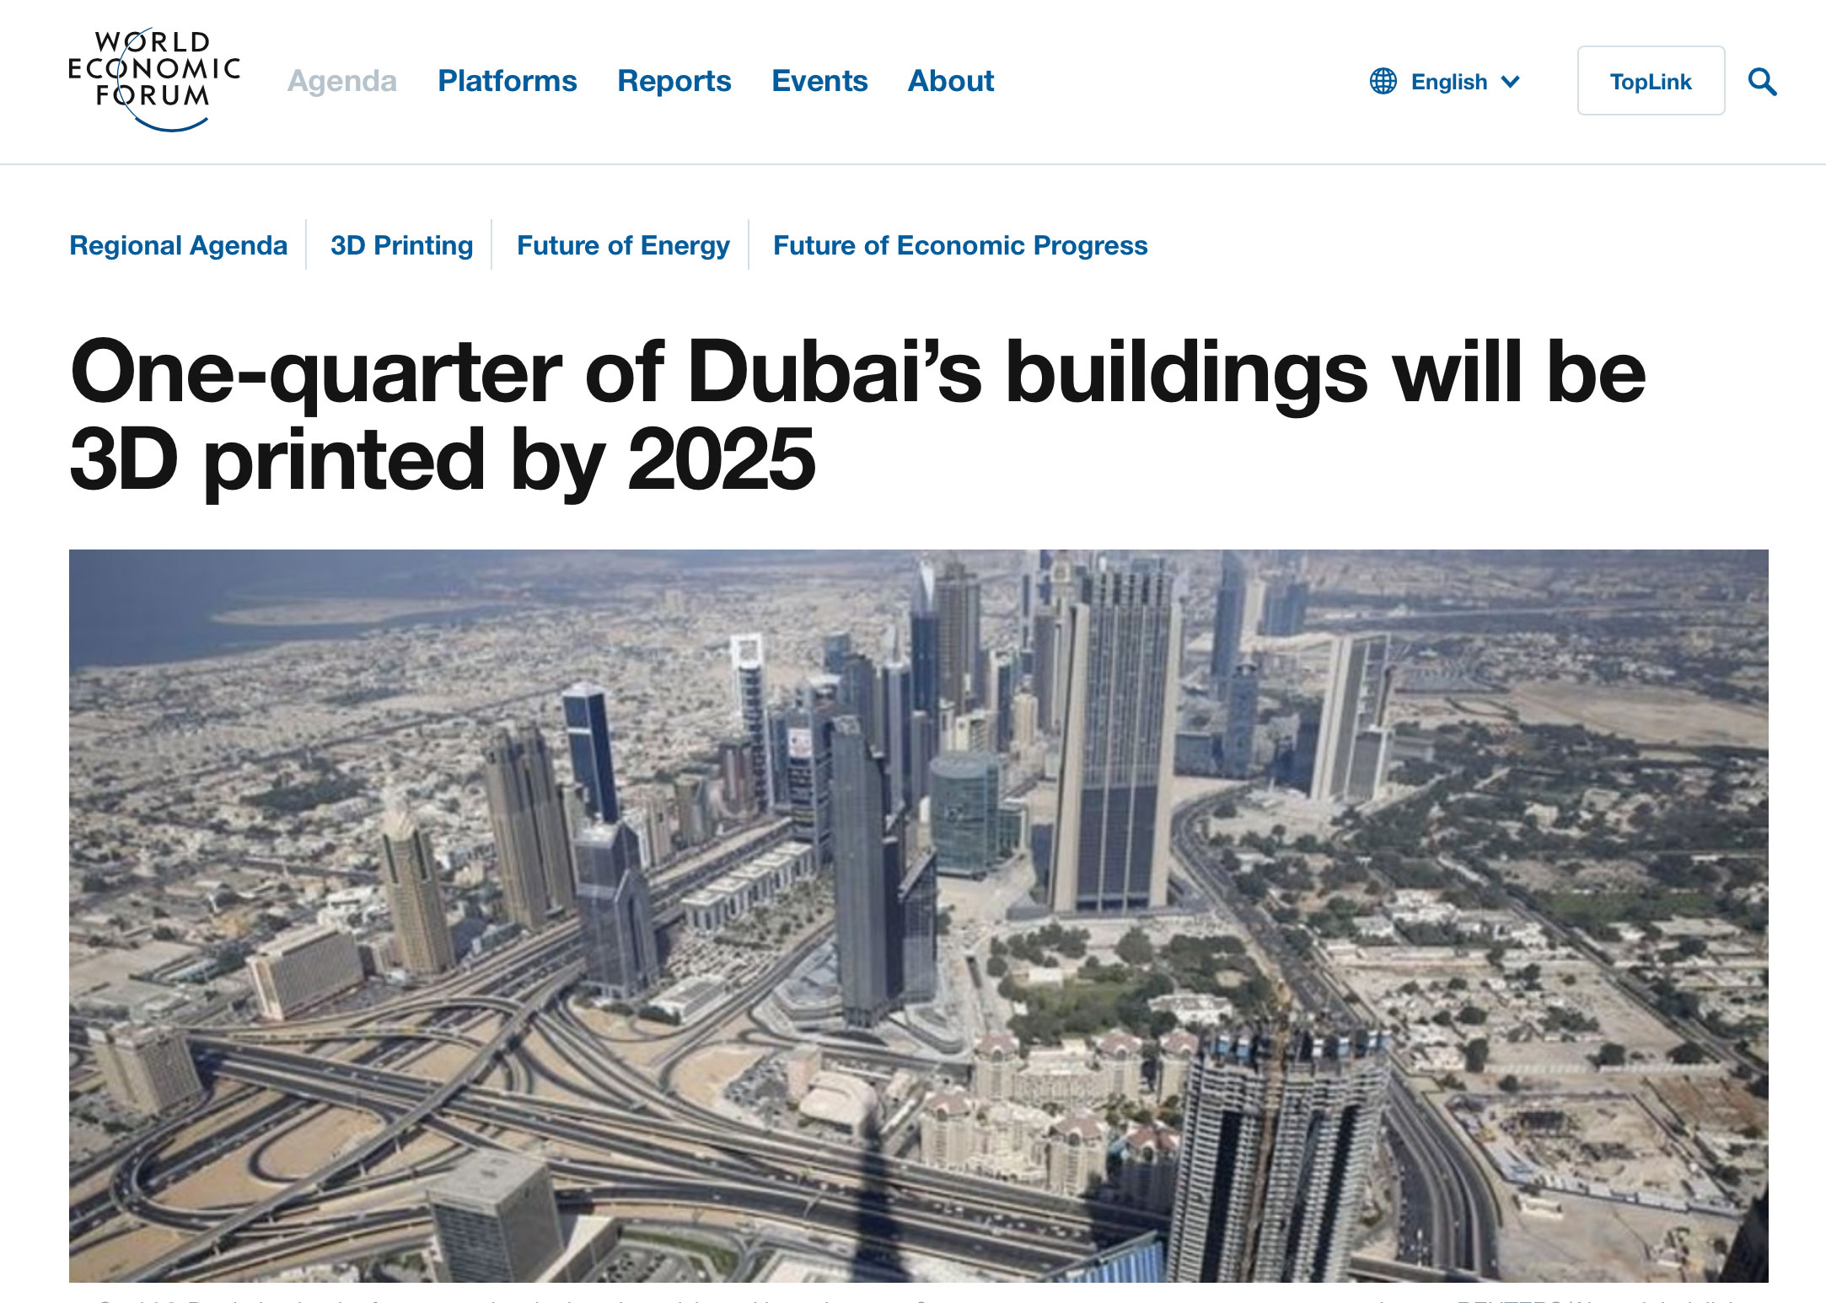
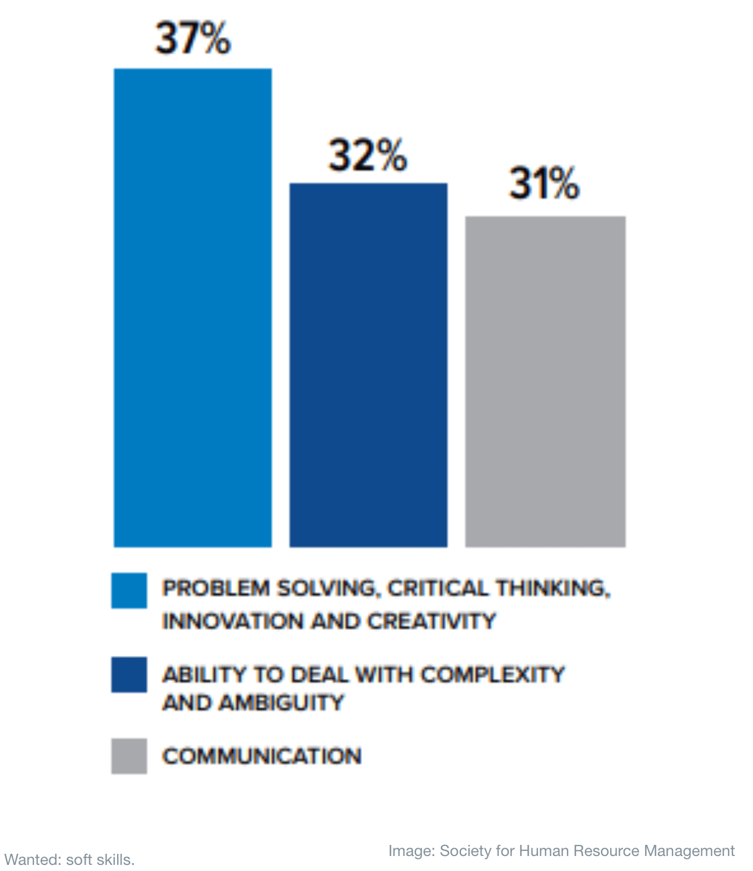
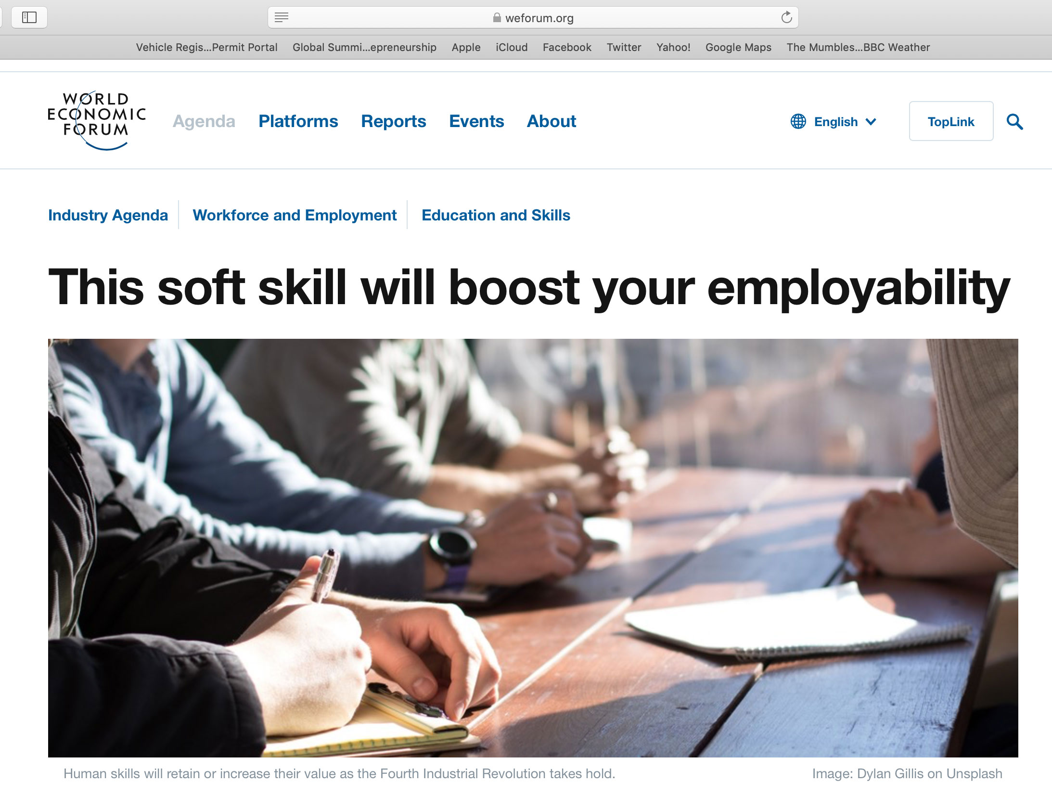

Slide 39
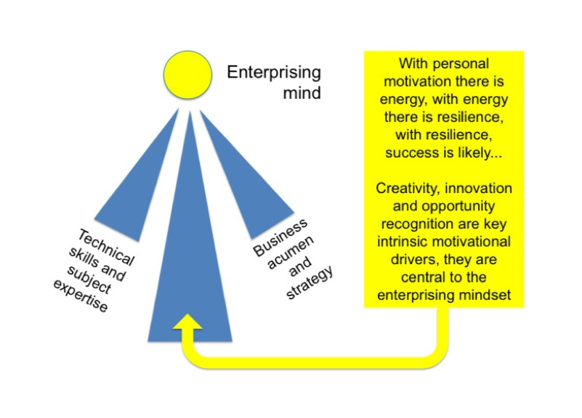
Decisions, decisions…
important questions to ask yourself
In 2014 the All Party Parliamentary Group for Micro Business asked their members in the UK what they wanted from an employee.
The answer was remarkably simple, they wanted people who knew their subject, knew a bit about the world of business but above all, were motivated learners who could be creative and innovative on their behalf.
* A LinkedIn survey in 2018 indicated that these enterprising skills are in greater demand than subject expertise!
(https://learning.linkedin.com/resources/workplace-learning-report-2018)
Anderson, S., Culkin, N. Penaluna, A and Smith, K (2014) An Education System fit for an Entrepreneur: 5th report of the All Parliamentary Group for MicroBusinesses. London: The Stationery Office, p17.

Slide 40
Read all about it
Entrecomp
https://ec.europa.eu/jrc/en/publication/eur-scientific-and-technical-research-reports/entrecomp-action-get-inspired-make-it-happen-user-guide-european-entrepreneurship-competence

